Slide 1
Gamification In Education
Presented By: Charles Pezanko

Slide 2
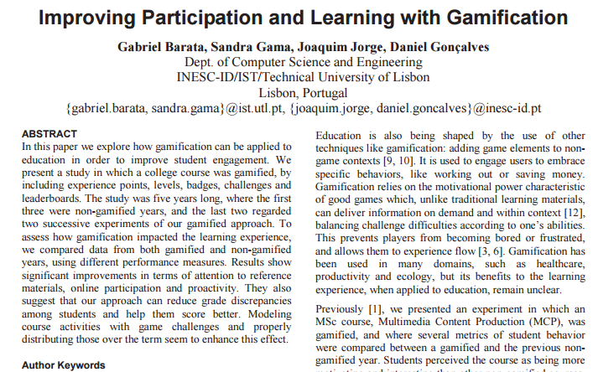
Gabriel Barata
Sandra Gama
Joaquim Jorge
Daniel Goncalves
https://www.researchgate.net/publication/259821680_Improving_Participation_and_Learning_with_Gamification

Slide 3

Purpose of Research Article
Explore how gamification can improve student engagement
Test previous research surrounding gamified learning
5 year study
University of Lisbon
First 3 years were traditional
Final 2 years were gamified courses
Introduced gaming conventions
Experience Points
Levels
Badges
Challenges & Leaderboards

Slide 4
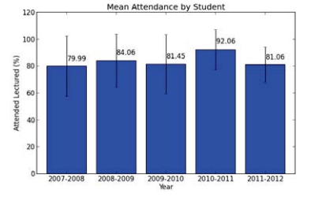
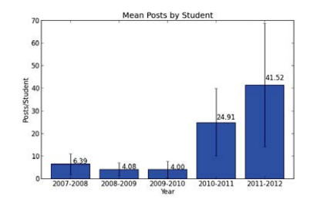
Research Results
Increased Attendance
Increased Post Creation & Replies
12% increase from year 1 to year 4
Challenge posts, reward no XP, had 52% response rate 2010-2011, and 73% rate in 2011-2012
Notes:
Even though the second gamified year’s average decreased, the lowest point of attendance was still higher than the lowest of any of the 3 gamified years.

Slide 5

Research Conclusion
Student Feedback Questionnaire
Considered gamified course to be more motivating
Gamified course required more work but was not more difficult
Challenges and extra non credited work was beneficial and still rewarding
Agreed gamification should be extended to other courses

Slide 6

Research Conclusion
No significant change in final grades
Attendance was strong the first gamified year, but dropped again the second
Lecture downloads increased 1.5 – 3 times though
The first gamified year had too much frontloaded activities leaving the second half deprived of content
Overall participation increased significantly compared to traditional courses

Slide 7

Background
Gamification is being used all over
Health & Fitness
Business
Chores
Technology can positively impact learning
Singapore is a master of this!
Games teach us it’s rules and logic through engagement

Slide 8

The Big Question
Can game design and logic increase participation in learning?
Three people helping me out
Pre-school Teacher
Sunday School Teacher
High School Teacher
Use progressive growth rather than traditional grading
Theoretically the numbers will net that same calculable results
Does perception matter to the student more than the grading method?
Notes:
Discuss assistance in helping develop learning plans with pre-school and high-school teacher to accommodate gamification. Also how curriculum for Sunday School was changed to allow for more games and activities attributed to learning. Sunday School surprisingly does this a bit already.

Slide 9

The Other Questions
What’s most valuable in education?
Participation vs. Grades
Can gamification stay constructive and concise?
Does gamification hold long and/or short term?
How to best gather results in a short period?
Is second hand assistance going to have an effect on results?
Does any of this even matter?

Slide 10
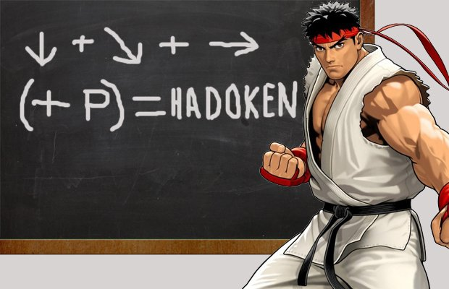
Thank You!

